Slide 1
Week 4
Filters (an introduction)
Asynchronous Tasks
Image capture
Notes:
Things to improve:
Confusion about copying into/out of OS-provided buffers

Slide 2
Overview
We’ll be taking a brief look at filtering
An indepth treatment would take many weeks
This will be enough to cover the absolute basics
How to use a filter
How to create the most basic of filters
Two methods of actually applying the filter to data
We will NOT cover filter design
If you want to learn this, take EE 442
More filter design than you will ever want
Still only covers FIR and IIR, doesn’t cover adaptive, Wiener, etc…
For the curious, the only filter design we’ll touch is windowed FIR

Slide 3
Signals and Systems
Signals are collections of (sampled) data
Timeseries such as audio
Spacial datasets such as images
Systems are objects which manipulate signals
Typically characterized by their “input/output” relationships
In the diagram below, we say y[n] is x[n] passed through H
x[n]
H
y[n]

Slide 4
Filters
Filters are systems which operate on frequencies
They allow certain frequencies to pass through, but not others
A “lowpass” filter allows low frequencies to pass through
A “highpass” filter likewise allows high frequencies through
The first thing to realize is no filter is perfect
No filter will pass everything you want while stopping everything you don’t
Everything is a balance between different parameters you can control
We won’t study how to design filters
We will, however, study properties of filters and how to use them
This requires knowing what filters can and cannot do

Slide 5
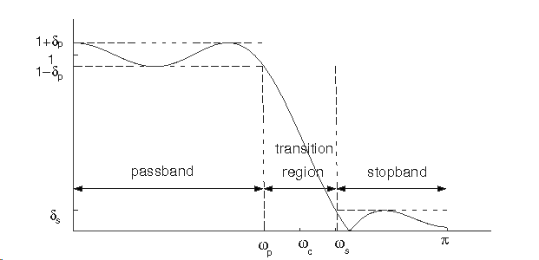
Filters – Frequency
Filters can be characterized a few different ways
We’ll start by looking at their properties in the frequency domain
Our filters have the following freq-domain attributes:
Passband gain and bandwidth
Stopband attenuation
Transition bandwidth

Slide 6
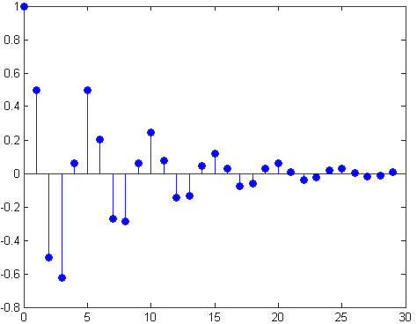
Filters – Time
Filters are themselves characterized by a signal
This is called the “impulse response” of the filter
We obtain those frequency-domain plots by Fourier transforming the impulse response of the filter, taking the magnitude and plotting it
The time-domain property we care about is length
Anything else is best left to
a Filter Design course

Slide 7
Filtering
We apply a filter a signal via “convolution”
Remember, a filter is really just a signal as well, an “impulse response”
Convolution combines two signals, creating a third
I’m sure you all remember convolution:
In discrete time, with h[n] the impulse response of the filter, x[n] the signal:
Why convolution? Where does it come from?
The answer lies within the Fourier transform

Slide 8
Convolution
One of the basic properties of the Fourier Transform
“Convolution in time is multiplication in frequency”
Therefore, the Fourier Transform of y[n] is simply:
This gives us a simple intuition with filters
They apply a scaling at each frequency
This scaling coefficient is simply H[k], the Fourier transform of h[n]

Slide 9
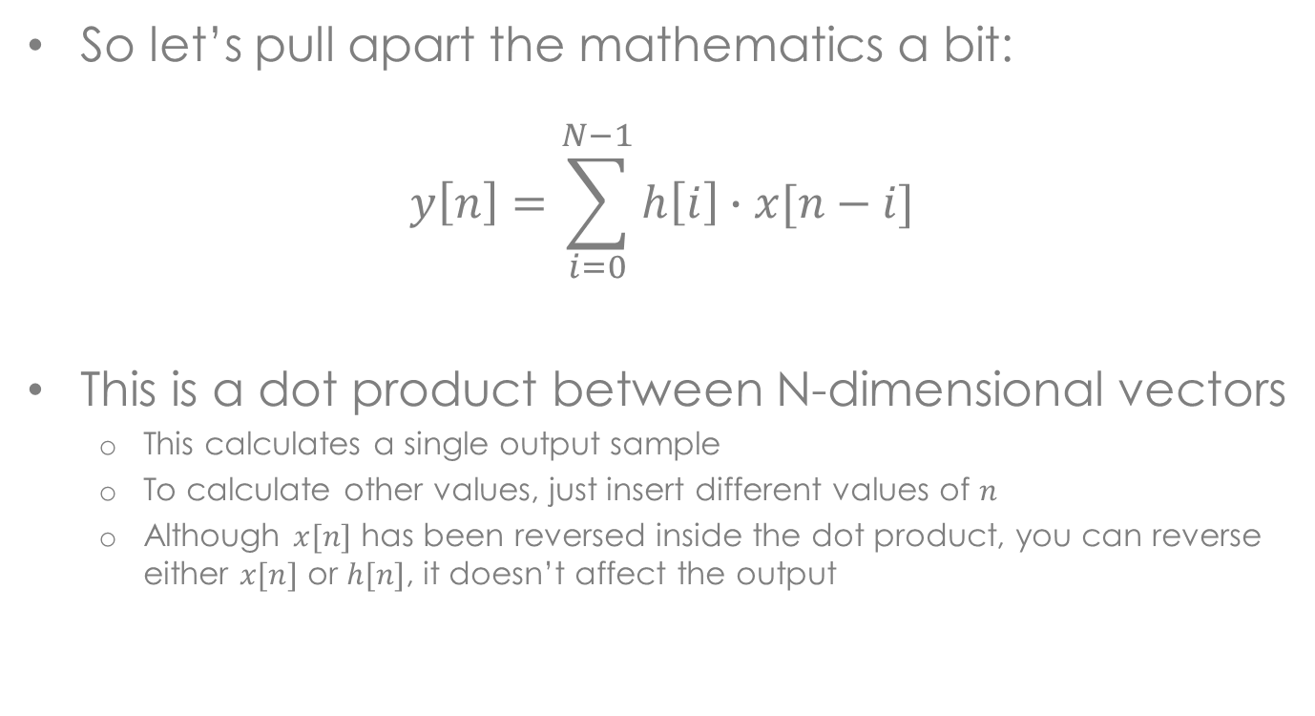
Convolution
So let’s pull apart the mathematics a bit:
$$y\left[n\right]=\sum_{i=0}^{N−1}{h\left[i\right]}∙x[n−i]$$
This is a dot product between N-dimensional vectors
This calculates a single output sample
To calculate other values, just insert different values of $n$
Although $x[n]$ has been reversed inside the dot product, you can reverse either $x[n]$ or $h[n]$, it doesn’t affect the output

Slide 10





Convolution
For those of you familiar with algorithmic complexity
Convolution is not particularly efficient
To convolve faster and better, we can use that Fourier property:
“Convolution in time is multiplication in frequency”
Why not just multiply to begin with!
$$x\left[n\right]$$
DFT
$$X\left[k\right]$$
IFT
$$y\left[n\right]$$
×
$$h\left[n\right]$$
DFT
$$H\left[k\right]$$

Slide 11
Circular Convolution
This performs “Circular Convolution”
Slightly different from Linear convolution
Typically performed in windowed chunks of input
Causes the tail end of the convolution to “wrap around” to the beginning
Due to DFT’s periodic assumption
Be aware of this when convolving with your signal
Windowing will take care of some of this, not all of it
By windowing, I mean multiplication with a window function:
Hann, Hamming, Blackman, Kaiser, etc…
Zero-padding can solve this for you!
Zero-pad both signals to a length that will contain the entire convolution
If you want to do this, don’t forget Overlap-and-Add!

Slide 12
Circular Convolution

Slide 13
Asynchronous Tasks
Let’s wash the EE stuff down with some CS concepts
C# has some more goodies for us
Sometimes, we want to execute things asynchronously
But we don’t want/need to do them simultaneously
Enter the async and await keywords
The former modifies function declarations
The latter modifies function calls
private async void myGreatFunction()
{
...
float[] result = await myOtherGreatFunction();
}

Slide 14
Asynchronous Tasks
You must use async on any function with await in it
The await keyword tells the compiler “wait for this”
Execution of the current function stops until done waiting
Execution then resumes
Internally, this is making extensive use of Dispatcher
The compiler reaches a condition inside of an await
Execution stops, all code after the condition is given to the Dispatcher
Eventually, the condition is cleared, and the Dispatcher continues
This is really useful for waiting for external events
Files loading, shaders compiling, network resources arriving, etc…

Slide 15
Asynchronous Tasks
async Task<int> AccessTheWebAsync()
{
HttpClient client = new HttpClient();
Task<string> data = client.GetStringAsync("http://msdn.microsoft.com");
// You can do work here that doesn't rely on [data]
DoIndependentWork();
string urlContents = await data;
// The return statement specifies an integer result.
// Any methods that are awaiting AccessTheWebAsync retrieve the length value.
return urlContents.Length;
}

Slide 16
Asynchronous Tasks
All async methods return a Task
This wraps around the desired return type
Asynchronous methods return before their work is “complete”
This allows synchronous methods to explicitly wait for the condition
Only happens once you access the Result property
private void myGreatFunction()
{
Task<int> taskData = AccessTheWebAsync();
int data = taskData.Result;
}

Slide 17
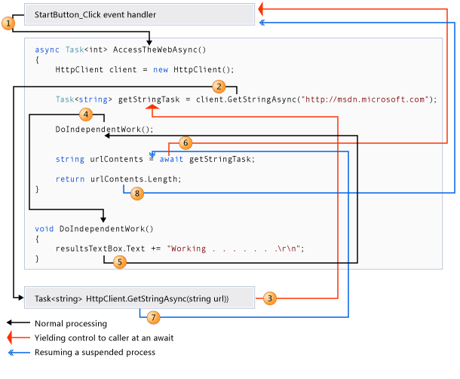
Asynchronous Tasks

Slide 18
Asynchronous Tasks
We won’t be using them this week
We will be using them next week
And the week after
And the week after…
Useful when dealing with time-intensive operations
Time-intensive: more than a few milliseconds!

Slide 19
Image Capture
We’re going to study the absolute basics today
We’ll follow up with a much more thorough treatment next week
At the end of this section, you will be able to
Take a photo
Display it to the user
Save it to the photo library
Next week we’ll learn all the nitty gritty
Hooking up a viewfinder
Being able to process the preview buffer
Controlling Flash, Focus, etc…

Slide 20
Image Capture
We will make use of the PhotoCamera class
Gives us a CaptureImageAvailable event we can subscribe to
Offers a CaptureImage method we can call to take the picture
That event, triggered after calling CaptureImage, gives us a Stream full of image data
Streams are Microsoft’s memory I/O interfaces
Examples include FileStream, MemoryStream, NetworkStream, etc.
We can pipe the Stream into a BitmapImage, which we can feed to XAML
The XAML element we’ll be using is called, (surprise surprise) Image
This all must happen after Initialization, of course
To initialize properly, we must use a VideoBrush

Slide 21
Camera Initialization
Create a PhotoCamera that uses the back camera
cam = new PhotoCamera(CameraType.Primary);
Subscribe to desired events
At least Initialized and CaptureImageAvailable recommended
Create BitmapImage and VideoBrush
Hook VideoBrush up to the camera to initialize it (We MUST do this)
Hook BitmapImage up to the Image XAML element so we can update it
bitmap = new BitmapImage();
brush = new VideoBrush();
brush.SetSource(cam);
xamlImage.Source = bitmap;

Slide 22
Image Capture
When our CaptureImageAvailable event is called
Just update our Bitmaps “source”
bitmap.SetSource(e.ImageStream);
This can crash, can anyone tell me why?
That’s all there is to Image Capture for now
Last thing to do is save this image to the Photo Library
That is something you will have to look up by yourself
Hint: Microsoft.Xna.Framework.Media.MediaLibrary is your friend

Slide 23
Homework 4
A two-parter!
Part 1: Create an audio filtering app
I will provide a FilterDesign object to create Windowed FIR filters
Use the Slider control to set the center frequency and bandwidth
Take input audio, filter it, spit it out
Yes, you will be writing the filtering routines
Straight-up linear convolution, save circular for later
Note that logarithmic mapping will likely make your sliders more useful
Part 2: Camera basics
Take images in from the Camera
Display them to the user
Save them to the media library
This is an excellent opportunity to learn how to have multiple apps in the same solution, please do this so your homework submission is one .zip file

Slide 24
Misc. info for HW 4
Don’t forget to lookup all the permissions needed
Getting “Invalid Operation” exceptions is a good indicator that you forgot
If you want to use a Stream more than once, you need to “rewind” it. Use the Seek function to do that
myStream.Seek(0, SeekOrigin.Begin);
The camera can take time to initialize
Communicate to your user somehow that the camera is ready

